Slide 1
Spring-Hibernate tutorial
Spring Live (chapter 2 posted online)

Slide 2
What is appfuse?
AppFuse is an open-source Java EE web application framework. It is designed for quick and easy start up of development, while also using open-source Java technologies such as Spring framework, Hibernate and Struts. AppFuse was originally created by Matt Raible, who wanted to eliminate the "ramp up" time in building new web applications.
AppFuse provides a project skeleton, similar to the one that's created by an IDE when one clicks through a "new web project" wizard. AppFuse 1.x uses Ant to create the project, as well as build/test/deploy it, whereas AppFuse 2.x uses Maven 2 for these tasks. IDE support was improved in 2.0 by leveraging Maven plugins to generate IDE project files. AppFuse 1.x uses XDoclet and JDK 1.4+.
Unlike other "new project" wizards, the AppFuse wizard creates a number of additional classes and files that implement features, but also serve as examples for the developer. The project is pre-configured to talk to a database, to deploy in an appserver, and to allow logging in.
When AppFuse was first developed, it only supported Struts and Hibernate. In version 2.x, it supports Hibernate, iBATIS or JPA as persistence frameworks. For implementing the MVC model, AppFuse is compatible with JSF, Spring MVC, Struts 2 or Tapestry.

Slide 3
Appfuse
Features integrated into AppFuse includes the following:
Authentication and Authorization
Remember Me (saving your login information so you don't have to login every time)
/Registration
SSL Switching
E-Mail
URL rewriting
Skinnability
Page Decoration
Templated Layout
File Upload
This out-of-the-box functionality is one of the main features in AppFuse that separates it from the other "CRUD Generation" frameworks, including Ruby on Rails and Grails. The aforementioned framework, as well as AppFuse, allow you to create master/detail pages from database tables or existing model objects.

Slide 4
Tutorials posted with code
This tutorial is posted at
http://www.scribd.com/doc/7074123/Spring-Live-Matt-Raible
A newer tutorial has been posted at
http://www.sourcebeat.com/titles/springlive/public/Rev_12/SpringLive_SampleChapter.pdf
code online for both tutorials:
http://svn.sourcebeat.com/svn/sourcebeat/trunk/downloads/

Slide 5
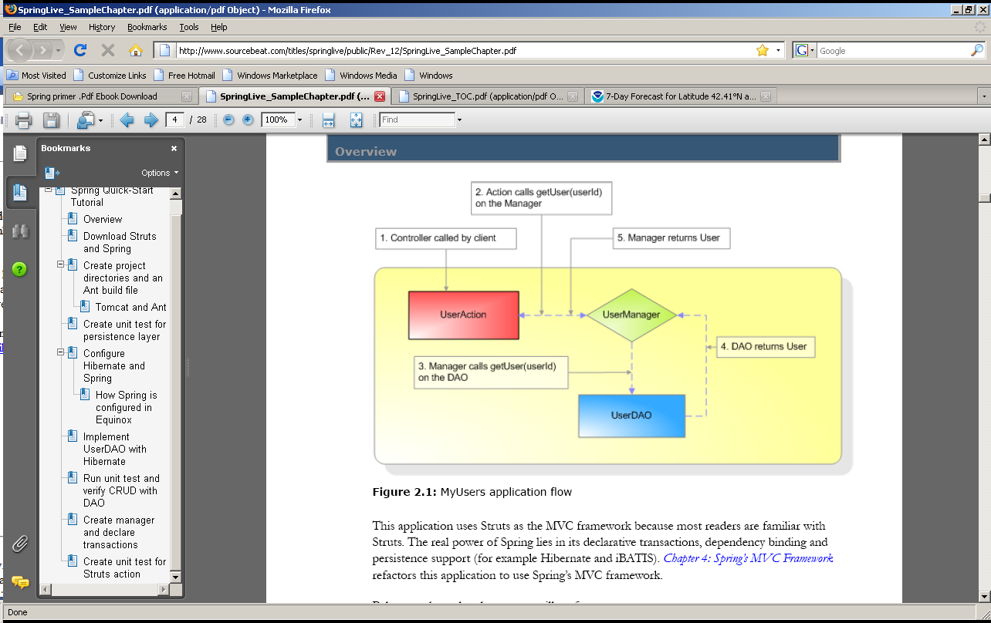

Slide 6
The tutorial covers
Below are the ordered steps you will perform:
1. Download Struts and Spring.
2. Create project directories and an Ant build file.
3. Create a unit test for the persistence layer.
4. Configure Hibernate and Spring.
5. Create Hibernate DAO implementation.
6. Run the unit test and verify CRUD with DAO.
7. Create manager and declare transactions.
8. Create a unit test for the Struts action.
9. Create an action and model (DynaActionForm) for the web layer.
10. Run the unit test and verify CRUD with action.
11. Create JavaServer Pages (JSPs) to allow CRUD through a web browser.
12. Verify the JSPs’ functionality through your browser.
13. Add Validation use Commons Validator.

Slide 7
Downloads and environment variables
Download Struts and Spring1
1. Download and install the following components:
􀀗 Java Development Kit (JDK) 1.4.2 (or above)
􀀗 Tomcat 5.0+
􀀗 Ant 1.6.1+
2. Set up the following environment variables:
􀀗 JAVA_HOME
􀀗 ANT_HOME
􀀗 CATALINA_HOME
3. Add the following to your PATH environment variable:
􀀗 JAVA_HOME/bin
􀀗 ANT_HOME/bin
􀀗 CATALINA_HOME/bin

Slide 8
The approach
To develop a Java-based web application, developers usually download JARs, create a directory
structure, and create an Ant build file. For a Struts-only application, this can be simplified
by using the struts-blank.war, which is part of the standard Struts distribution. For a web app
using Spring’s MVC framework, you can use the webapp-minimal application that ships with
Spring. Both of these are nice starting points, but neither simplifies the Struts-Spring integration
nor takes into account unit testing. Therefore, I created Equinox, both for this book and
to help developers get started quickly with Spring.
Equinox is a bare-bones starter application for creating a Spring-based web application. It has
a pre-defined directory structure, an Ant build file (for compiling, deploying and testing), and
all the JARs you will need for a Struts, Spring and Hibernate-based web app. Much of the
directory structure and build file in Equinox is taken from my open source AppFuse application.
Therefore, Equinox is really just an “AppFuse Light” that allows rapid web app development
with minimal setup. Because it is derived from AppFuse, you will see many references to
it in package names, database names and other areas. This is done purposefully so you can
migrate from an Equinox-based application to a more robust AppFuse-based application.
In order to start MyUsers, download Equinox 1.0 from sourcebeat.com/downloads and
extract it to an appropriate location.
Download equinox: http://www.sourcebeat.com/downloads

Slide 9
Create project directories and an Ant build file
To set up your initial directory structure and Ant build file, extract the Equinox downloadonto your hard drive. I recommend putting projects in C:\Source on Windows and ~/devon Unix or Linux. For Windows users, now is a good time set your HOME environment variable to C:\Source. The easiest way to get started with Equinox is to extract it to your preferred source location, cd into the equinox directory and run ant new -Dapp.name=myusers from the command line.
Warning: You must have the CATALINA_HOME environment variable set, or building MyUsers will not work. This is because its build.xml depends on a catalina-ant.jar file for running Tomcat’s Ant tasks (covered shortly). As an alternative, you can specify a Tomcat.home property in build.properties that points to your Tomcat installation.

Slide 10
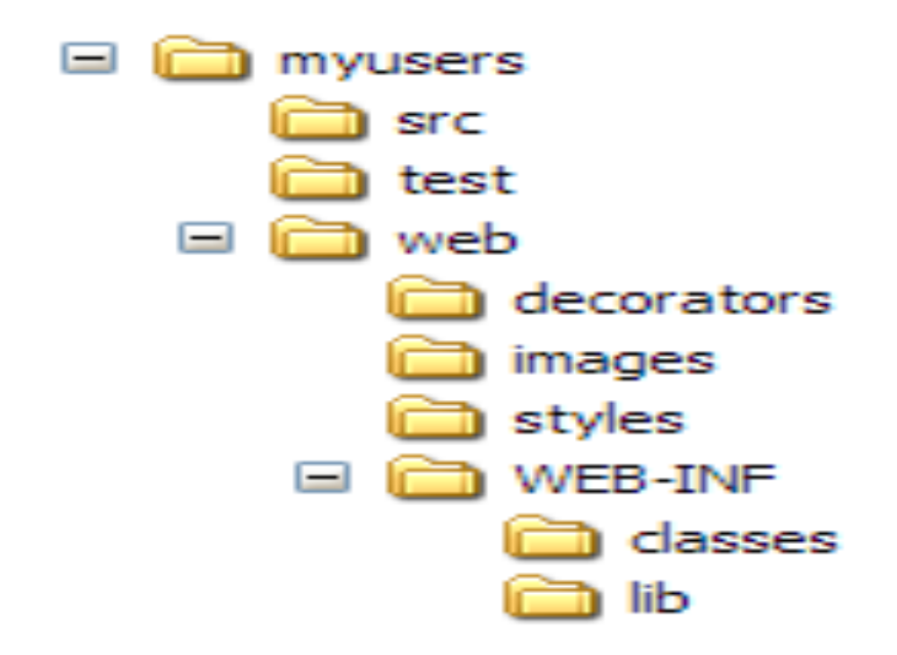
Directory structure

Slide 11
Type ant in the MyUsers directory to see options
[echo] Available targets are:
[echo] compile --> Compile all Java files
[echo] war --> Package as WAR file
[echo] deploy --> Deploy application as directory
[echo] deploywar --> Deploy application as a WAR file
[echo] install --> Install application in Tomcat
[echo] remove --> Remove application from Tomcat
[echo] reload --> Reload application in Tomcat
[echo] start --> Start Tomcat application
[echo] stop --> Stop Tomcat application
[echo] list --> List Tomcat applications
[echo] clean --> Deletes compiled classes and WAR
[echo] new --> Creates a new project

Slide 12
Tomcat and Ant
Tomcat ships with a number of Ant tasks that allow you to install, remove and reload web apps using its Manager application. The easiest way to declare and use these tasks is to create a properties file that contains all the definitions. In Equinox, a tomcatTasks.properties file is in the base directory with contents:
    deploy=org.apache.catalina.ant.DeployTask
    undeploy=org.apache.catalina.ant.UndeployTask
    remove=org.apache.catalina.ant.RemoveTask
    reload=org.apache.catalina.ant.ReloadTask
    start=org.apache.catalina.ant.StartTask
    stop=org.apache.catalina.ant.StopTask
    list=org.apache.catalina.ant.ListTask

Slide 13
More of build.xml
<!-- Tomcat Ant Tasks -->
<taskdef file="tomcatTasks.properties">
<classpath>
<pathelement
path="${tomcat.home}/server/lib/catalina-ant.jar"/>
</classpath>
</taskdef>
<target name="install" description="Install application in Tomcat"
depends="war">
<deploy url="${tomcat.manager.url}"
username="${tomcat.manager.username}"
password="${tomcat.manager.password}"
path="/${webapp.name}"
war="file:${dist.dir}/${webapp.name}.war"/>
</target>
<target name="remove" description="Remove application from Tomcat">
<undeploy url="${tomcat.manager.url}"
username="${tomcat.manager.username}"
password="${tomcat.manager.password}"
path="/${webapp.name}"/>
</target>
<target name="reload" description="Reload application in Tomcat">

Slide 14
Build continued
<reload url="${tomcat.manager.url}"
username="${tomcat.manager.username}"
password="${tomcat.manager.password}"
path="/${webapp.name}"/>
</target>
<target name="start" description="Start Tomcat application">
<start url="${tomcat.manager.url}"
username="${tomcat.manager.username}"
password="${tomcat.manager.password}"
path="/${webapp.name}"/>
</target>
<target name="stop" description="Stop Tomcat application">
<stop url="${tomcat.manager.url}"
username="${tomcat.manager.username}"
password="${tomcat.manager.password}"
path="/${webapp.name}"/>
</target>
<target name="list" description="List Tomcat applications">
<list url="${tomcat.manager.url}"
username="${tomcat.manager.username}"
password="${tomcat.manager.password}"/>
</target>

Slide 15
Build.properties
  # Properties for Tomcat Server
  tomcat.manager.url=http://localhost:8080/manager
  tomcat.manager.username=admin
  tomcat.manager.password=admin
Edit $CATALINA_HOME/conf/tomcat-users.xml to make sure this line is there.
<user username="admin" password="admin" roles="manager"/>

Slide 16
Blackscreen test…type ant list
C:\equinox-1.0\myusers>ant list
Buildfile: build.xml
list:
[list] OK - Listed applications for virtual host localhost
[list] /:running:0:ROOT
[list] /manager:running:0:manager
[list] /StatefulCounterEJB:running:0:StatefulCounterEJB
[list] /myusers:running:0:myusers
[list] /ejb-examples-1.1:running:0:ejb-examples-1.1
[list] /blazeds:running:0:blazeds
[list] /HelloBean:running:0:HelloBean
[list] /jndiservlet:running:0:jndiservlet
[list] /docs:running:0:docs
[list] /openejb:running:0:openejb
[list] /LookupServlet:running:0:LookupServlet
[list] /ejb-examples:running:0:ejb-examples
[list] /myexamples:running:0:myexamples
[list] /hello-openejb:running:0:hello-openejb
[list] /HibernateWithMySQL:running:0:HibernateWithMySQL
[list] /examples:running:0:examples
[list] /host-manager:running:0:host-manager
[list] /HelloEjbService:running:0:
[list] /HibernateApp3:running:0:HibernateApp3
[list] /CurrentQuoteEJB:running:0:CurrentQuoteEJB
[list] /FtoCEJB:running:0:FtoCEJB
BUILD SUCCESSFUL
Total time: 1 second
C:\equinox-1.0\myusers>

Slide 17
installation
Running ant deploy will deploy myusers.

Slide 18
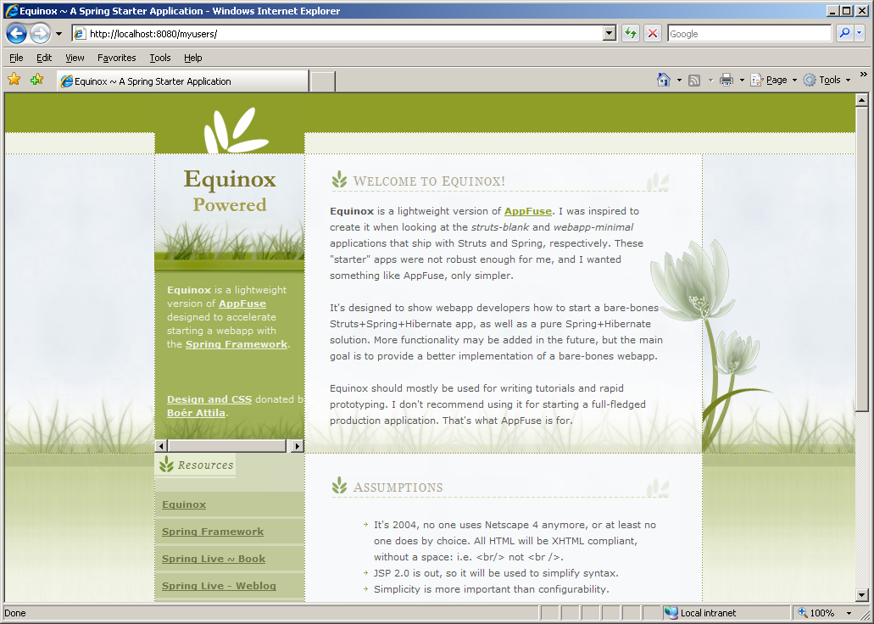
Test by going to 8080/myusers

Slide 19
Running the HSQLDB
Warning: In order for the in-memory HSQLDB to work correctly with MyUsers, start Tomcat from the same directory from which you run Ant. Type $CATALINA_HOME/bin/startup.sh on Unix/Linux and %CATALINA_HOME%\bin\startup.bat on Windows. You can also change the database settings to use an absolute path.

Slide 20
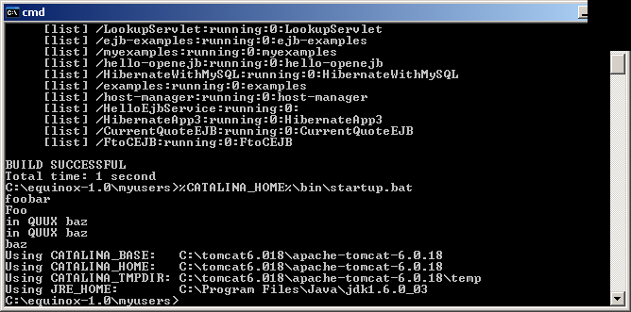

Slide 21
Create a UserDAOTest.java
1. Create a UserDAOTest.java class in the test/org/appfuse/dao directory. This class should
extend BaseDAOTestCase, which already exists in this package. This parent class
initializes Spring’s ApplicationContext from the web/WEB-INF/applicationContext.xml file.
Listing 2.6 is the code you will need to begin writing your UserDAOTest.java:
Listing 2.6
Note: Automatically importing necessary classes is a nice feature of modern IDEs like
Eclipse and IDEA. Equinox contains the project necessary for both of these IDEs.
This class won’t compile yet because you haven’t created your UserDAO interface. Before you
do that, write a couple of tests to verify CRUD works on the User object.
2. Add the testSave and testAddAndRemove methods to the UserDAOTest class, as
shown in Listing 2.7:
Listing 2.7
package org.appfuse.dao;
// use your IDE to handle imports
public class UserDAOTest extends BaseDAOTestCase {
private User user = null;
private UserDAO dao = null;
protected void setUp() throws Exception {
super.setUp();
dao = (UserDAO) ctx.getBean("userDAO");
}
protected void tearDown() throws Exception {
super.tearDown();
dao = null;
}
}

Slide 22
You’ll need to use netbeans or eclipse add imports (or search for them yourself)
Add the testSave and testAddAndRemove methods to the UserDAOTest class, as
shown
package org.appfuse.dao;
// use your IDE to handle imports
public class UserDAOTest extends BaseDAOTestCase {
private User user = null;
private UserDAO dao = null;
protected void setUp() throws Exception {
super.setUp();
dao = (UserDAO) ctx.getBean("userDAO");
}
protected void tearDown() throws Exception {
super.tearDown();
dao = null;}}
public void testSaveUser() throws Exception {
user = new User();
user.setFirstName("Rod");
user.setLastName("Johnson");dao.saveUser(user);
assertNotNull("primary key assigned", user.getId());
log.info(user);
assertNotNull(user.getFirstName());
}
public void testAddAndRemoveUser() throws Exception {
user = new User();
user.setFirstName("Bill");
user.setLastName("Joy");
dao.saveUser(user);
assertNotNull(user.getId());
assertEquals(user.getFirstName(), "Bill");
if (log.isDebugEnabled()) {
log.debug("removing user...");
}
dao.removeUser(user.getId());
assertNull(dao.getUser(user.getId()));
}

Slide 23
UserDAO
From these test methods, you can see that you need to create a UserDAO with the following
methods:
saveUser(User)
removeUser(Long)
getUser(Long)
getUsers() (to return all the users in the database)
3. Create a UserDAO.java file in the src/org/appfuse/dao directory and populate it with the
code in Listing 2.8:

Slide 24
Create a UserDAO.java file in the src/org/appfuse/dao directory
package org.appfuse.dao;
// use your IDE to handle imports
public interface UserDAO extends DAO {
public List getUsers();
public User getUser(Long userId);
public void saveUser(User user);
public void removeUser(Long userId);
}

Slide 25
Finally, in order for the UserDAOTest and UserDAO to compile, create a User object to persist.
Create a User.java class in the src/org/appfuse/model directory and add id, firstName
and lastName as member variables, as shown

Slide 26
class User
package org.appfuse.model;
public class User extends BaseObject {
private Long id;
private String firstName;
private String lastName;
/*
Generate your getters and setters using your favorite IDE:
In Eclipse:
Right-click -> Source -> Generate Getters and Setters
*/
}

Slide 27
Notice that you’re extending a BaseObject class which is already defined. It has methods: toString(), equals() and hashCode(). The latter two are required by Hibernate.

Slide 28
create a file named User.hbm.xml
In the src/org/appfuse/model directory, create a file named User.hbm.xml
<?xml version="1.0" encoding="UTF-8"?>
<!DOCTYPE hibernate-mapping PUBLIC
"-//Hibernate/Hibernate Mapping DTD 2.0//EN"
"http://hibernate.sourceforge.net/hibernate-mapping-2.0.dtd">
<hibernate-mapping>
<class name="org.appfuse.model.User" table="app_user">
<id name="id" column="id" unsaved-value="0">
<generator class="increment" />
</id>
<property name="firstName" column="first_name"
not-null="true"/>
<property name="lastName" column="last_name" not-null="true"/>
</class>
</hibernate-mapping>

Slide 29
Edit applicationContext.xml
Add this mapping to Spring’s applicationContext.xml file in the web/WEB-INF directory. Open this file and look for <property name="mappingResources"> and change it to :
<property name="mappingResources">
<list>
<value>org/appfuse/model/User.hbm.xml</value>
</list>
</property>
In the applicationContext.xml file, you can see how the database is set up and Hibernate is configured to work with Spring. Equinox is designed to work with an HSQL database named db/appfuse. It will be created in your project’s db directory. Details of this configuration will be covered in the “How Spring is configured in Equinox” section.

Slide 30
Run ant deploy reload to rebuild and redeploy
INFO - SchemaExport.execute(98) | Running hbm2ddl schema export
INFO - SchemaExport.execute(117) | exporting generated schema to database
INFO - ConnectionProviderFactory.newConnectionProvider(53) | Initializing
connection provider: org.springframework.orm.hibernate
.LocalDataSourceConnectionProvider
INFO - DriverManagerDataSource.getConnectionFromDriverManager(140) |
Creating new JDBC connection to [jdbc:hsqldb:db/appfuse]
INFO - SchemaExport.execute(160) | schema export complete

Slide 31
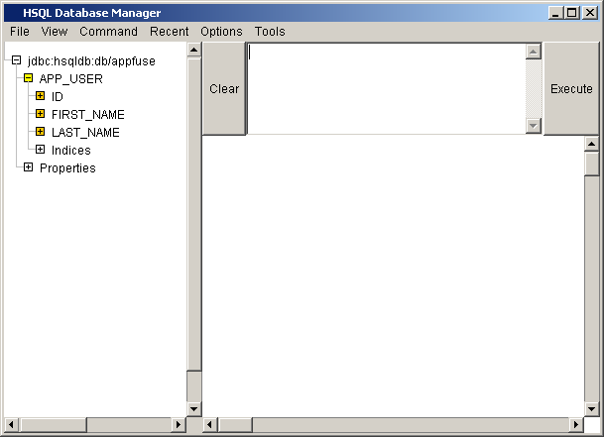
run ant browse to bring up a HSQL console to see the table (Tomcat must be running)

Slide 32
How Spring is configured in Equinox
It is very easy to configure any J2EE-based web application to use Spring. At the very least, you can simply add Spring’s ContextLoaderListener to your web.xml file
<listener>
<listener-class>
org.springframework.web.context.ContextLoaderListener
</listener-class>
</listener>
This is a ServletContextListener that initializes when your web app starts up. By default, it looks for Spring’s configuration file at WEB-INF/applicationContext.xml. You can change this default value by specifying a <context-param> element named contextConfig-
Location.

Slide 33
how does Spring know about Hibernate?
Look at the full contents of your applicationContext.xml file
<context-param>
<param-name>contextConfigLocation</param-name>
<param-value>/WEB-INF/sampleContext.xml</param-value>
</context-param>
<?xml version="1.0" encoding="UTF-8"?>
<!DOCTYPE beans PUBLIC "-//SPRING//DTD BEAN//EN"
"http://www.springframework.org/dtd/spring-beans.dtd">
<beans>
<bean id="dataSource"
class="org.springframework.jdbc.datasource.DriverManagerDataSource">
<property name="driverClassName">
<value>org.hsqldb.jdbcDriver</value>
</property>
<property name="url">
<value>jdbc:hsqldb:db/appfuse</value>
</property>
<property name="username"><value>sa</value></property>
<!-- Make sure <value> tags are on same line - if they're not,
authentication will fail -->
<property name="password"><value></value></property>
</bean>
<!-- Hibernate SessionFactory -->
<bean id="sessionFactory"
class="org.springframework.orm.hibernate.LocalSessionFactoryBean">
<property name="dataSource">
<ref local="dataSource"/>
</property>
<property name="mappingResources">
<list>
<value>org/appfuse/model/User.hbm.xml</value>
</list>
</property>
<property name="hibernateProperties">
<props>

Slide 34
continued
<prop key="hibernate.dialect">
net.sf.hibernate.dialect.HSQLDialect
</prop>
<prop key="hibernate.hbm2ddl.auto">create</prop>
</props>
</property>
</bean>
<!-- Transaction manager for a single Hibernate SessionFactory -->
<bean id="transactionManager"
class="org.springframework.orm.hibernate.HibernateTransactionManager">
<property name="sessionFactory">
<ref local="sessionFactory"/>
</property>
</bean>
</beans>

Slide 35
The first bean (dataSource) represents an HSQL database, and the second bean (session-Factory) has a dependency on that bean. Spring just calls setDataSource (DataSource) on the LocalSessionFactoryBean to make this work. If you wanted to use a Java Naming and Directory Interface (JNDI) DataSource instead, you could easily change this bean’s definition to something similar to
<bean id="dataSource"
class="org.springframework.jndi.JndiObjectFactoryBean">
<property name="jndiName">
<value>java:comp/env/jdbc/appfuse</value>
</property>
</bean>

Slide 36
Also note the hibernate.hbm2ddl.auto property in the sessionFactory definition. This property creates the database tables automatically when the application starts. Other possible values are update and create-drop.The last bean configured is the transactionManager (and nothing is stopping you from using a Java Transaction API — JTA — transaction manager), which is necessary to perform distributed transactions across two databases. If you want to use a JTA transaction manager, simply change this bean’s class attribute to org.springframework.transaction.jta.Jta-TransactionManager. Now you can implement the UserDAO with Hibernate.

Slide 37
The UserDAOHibernate.java class in src/org/appfuse/dao/hibernate (create dir first)
package org.appfuse.dao.hibernate;
// organize imports using your IDE
public class UserDAOHibernate extends HibernateDaoSupport implements
UserDAO {
private Log log = LogFactory.getLog(UserDAOHibernate.class);
public List getUsers() {
return getHibernateTemplate().find("from User");
}
public User getUser(Long id) {
return (User) getHibernateTemplate().get(User.class, id);
}
public void saveUser(User user) {
getHibernateTemplate().saveOrUpdate(user);
if (log.isDebugEnabled()) {
log.debug("userId set to: " + user.getId());
}
}
public void removeUser(Long id) {
Object user = getHibernateTemplate().load(User.class, id);
getHibernateTemplate().delete(user);
}
}

Slide 38
Spring’s HibernateDaoSupport class is a convenient super class for Hibernate DAOs. It has
handy methods you can call to get a Hibernate Session, or a SessionFactory. The most convenient
method is getHibernateTemplate(), which returns a HibernateTemplate. This
template wraps Hibernate checked exceptions with runtime exceptions, allowing your DAO
interfaces to be Hibernate exception-free.

Slide 39
Nothing is in your application to bind UserDAO to UserDAOHibernate, so you must create
that relationship.
2. For Spring to recognize the relationship, add the lines in Listing 2.18 to the web/WEBINF/
applicationContext.xml file.
<bean id="userDAO" class="org.appfuse.dao.hibernate.UserDAOHibernate">
<property name="sessionFactory">
<ref local="sessionFactory"/>
</property>
</bean>

Slide 40
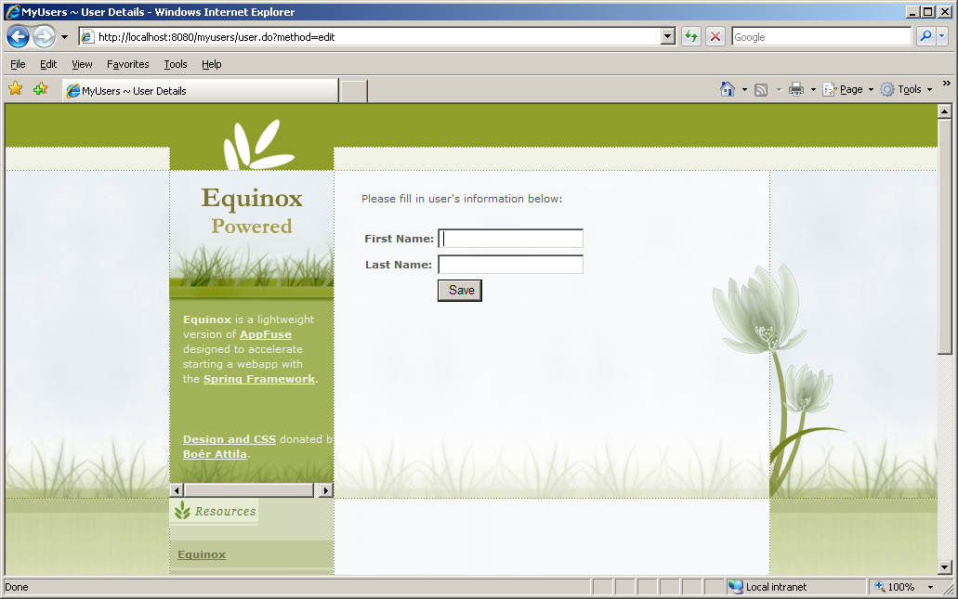
Note url…edit/add user

Slide 41
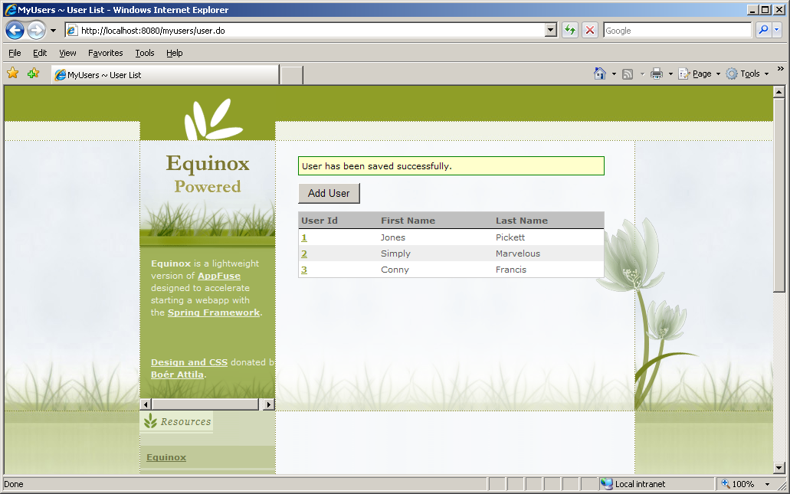
Added users…

